Slide 1
21CSC201J DATA STRUCTURES AND ALGORITHMS UNIT-4 Topic : AVL Trees

Slide 2
Adelson, Velski & Landis, AVL trees

Slide 3
Adelson, Velski & Landis, AVL trees
It is observed that BST's worst-case performance is closest to linear search algorithms, that is Ο(n). In real-time data, we cannot predict data pattern and their frequencies. So, a need arises to balance out the existing BST.
Named after their inventor Adelson, Velski & Landis, AVL trees are height balancing binary search tree. AVL tree checks the height of the left and the right sub-trees and assures that the difference is not more than 1. This difference is called the Balance Factor.

Slide 4
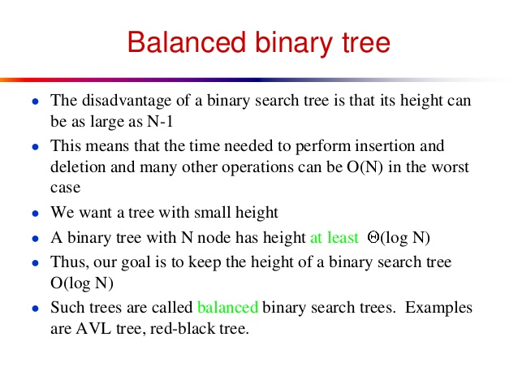

Slide 5
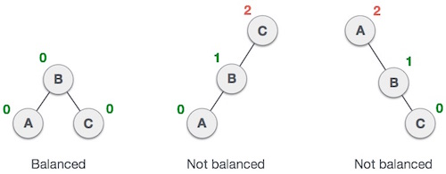
Balance Factor
BalanceFactor = height(left-sutree) − height(right-sutree)

Slide 6
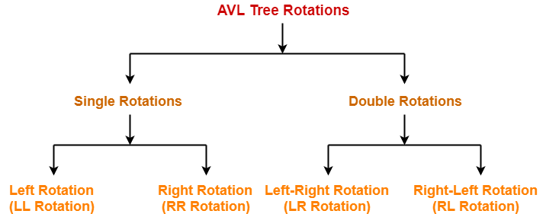

Slide 7
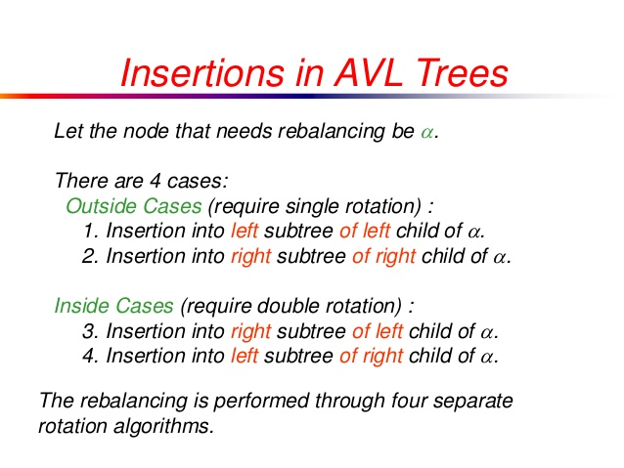

Slide 8
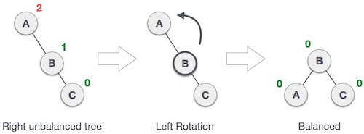
Left Rotation
If a tree becoen a node is inserted into the right subtmes unbalanced, whree of the right subtree, then we perform a single left rotation −

Slide 9
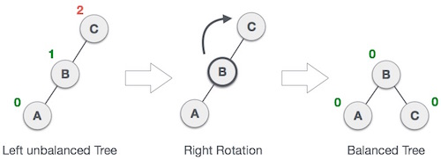
Right Rotation
AVL tree may become unbalanced, if a node is inserted in the left subtree of the left subtree. The tree then needs a right rotation.

Slide 10
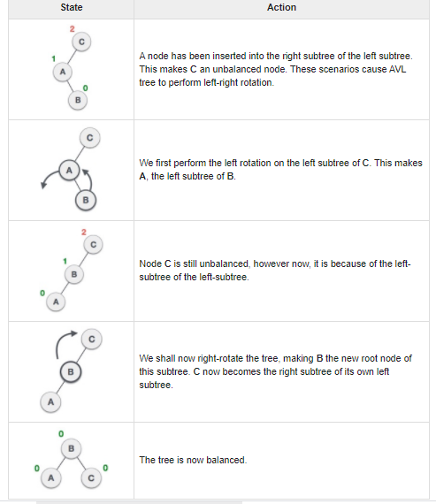
Left-Right Rotation
A left-right rotation is a combination of left rotation followed by right rotation.

Slide 11
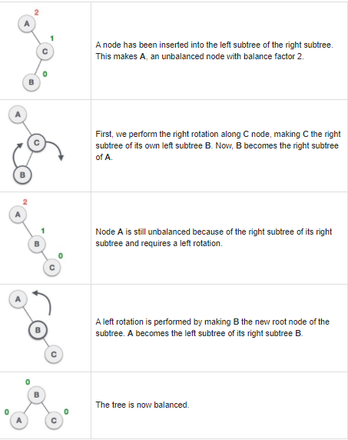
Right-Left Rotation
The second type of double rotation is Right-Left Rotation. It is a combination of right rotation followed by left rotation.

Slide 12
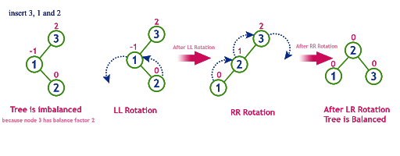

Slide 13
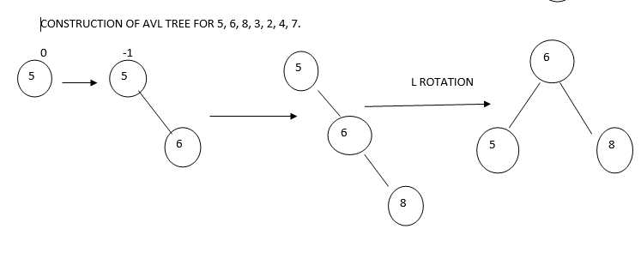

Slide 14
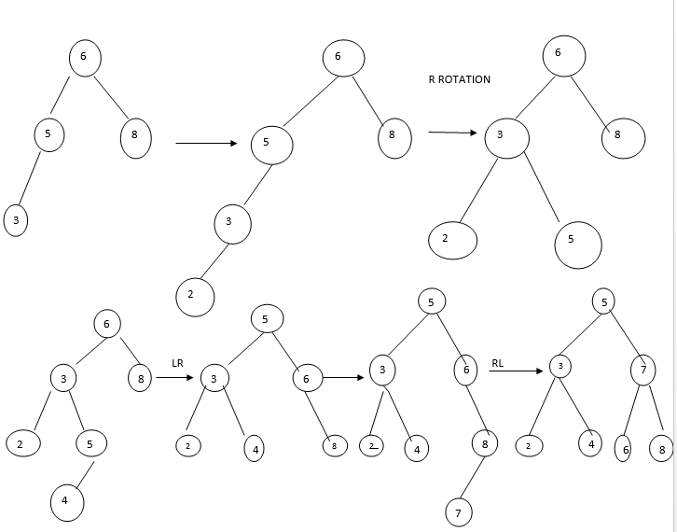

Slide 15
heaps

Slide 16
Heaps
A third type of tree is a heap.
A heap is a binary tree whose left and right subtrees have values less than their parents.
The root of a maxheap is guaranteed to hold the largest node in the tree; its subtrees contain data that have lesser values.
Unlike the binary search tree, however, the lesser-valued nodes of a heap can be placed on either the right or the left subtree.
Heaps have another interesting facet: they are often implemented in an array rather than a linked list.

Slide 17
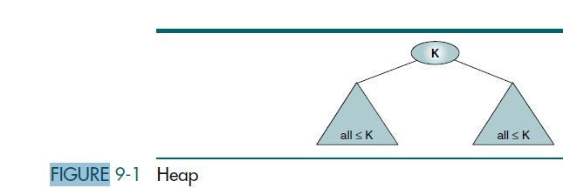
Definition
A heap, as shown in Figure 9-1, is a binary tree structure with the following
properties:
1. The tree is complete or nearly complete.
2. The key value of each node is greater than or equal to the key value in each of its descendants.
A heap is a complete or nearly complete binary tree in which the key value in a node is greater than or
equal to the key values in all of its subtrees, and the subtrees are in turn heaps.

Slide 18
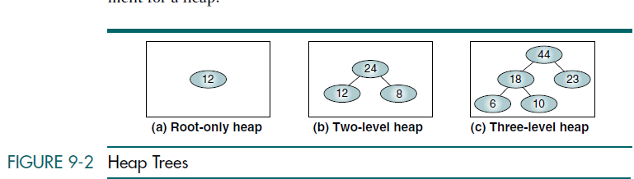

Slide 19
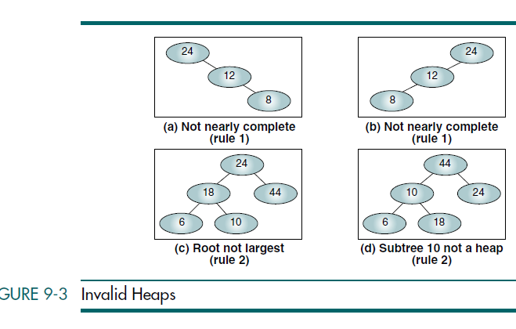

Slide 20
Heap Operations
Two basic maintenance operations are performed on a heap:
insert a node
and delete a node.
To implement the insert and delete operations, we need two basic algorithms: reheap up and reheap down.

Slide 21
Reheap Up
The reheap up operation reorders a “broken” heap by floating the last element up the tree until it is in its correct location in the heap.

Slide 22
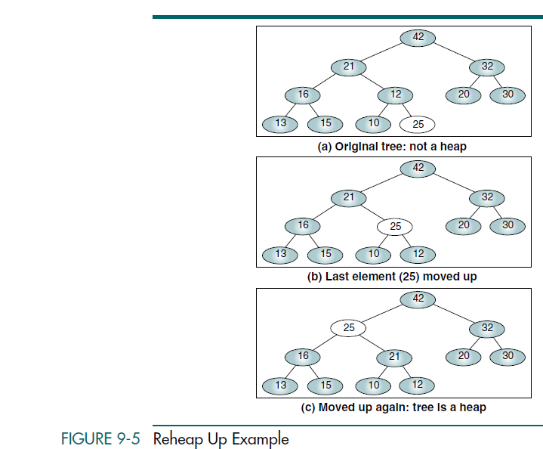

Slide 23
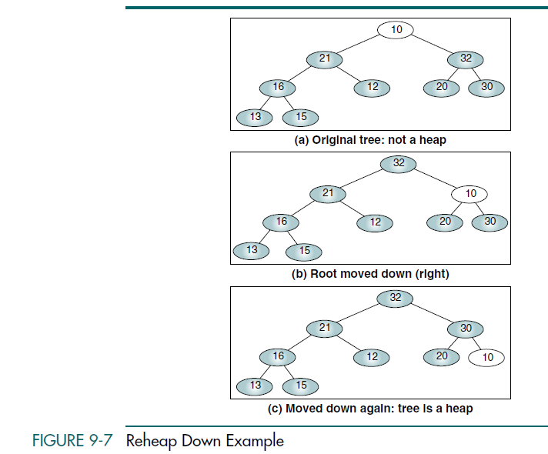

Slide 24
Heap Implementation
Although a heap can be built in a dynamic tree structure, it is most often implemented in an array. This implementation is possible because the heap is, by definition, complete or nearly complete. Therefore, the relationship
between a node and its children is fixed and can be calculated as shown below.
1. For a node located at index i, its children are found at:
a. Left child: 2i + 1
b. Right child: 2i + 2
2. The parent of a node located at index i is located at [(i – 1) / 2]
3. Given the index for a left child, j, its right sibling, if any, is found at j + 1.
Conversely, given the index for a right child, k, its left sibling, which must exist, is found at k – 1

Slide 25
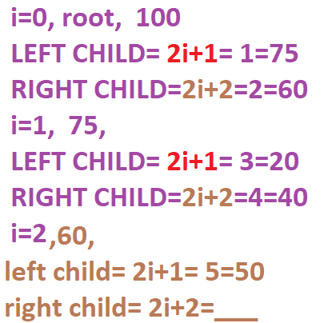
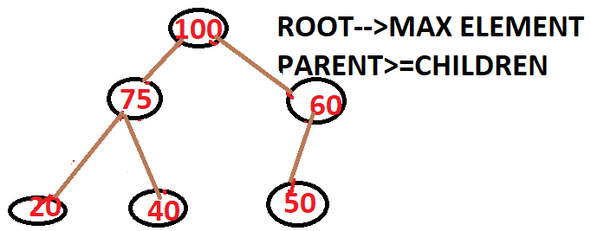
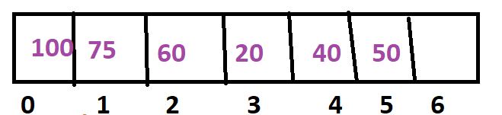
4. Given the size, n, of a complete heap, the location of the first leaf is [(n / 2)]
Given the location of the first leaf element, the location of the last non leaf
element is one less.
parent= (i-1)/2
parent of 40, i=4
parent=3/2=1= 75

Slide 26
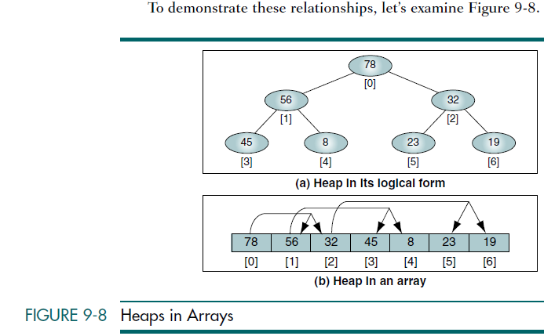
A heap can be implemented in an array because it must be a complete or nearly complete binary tree, which allows a fixed relationship between each node and its children.

Slide 27
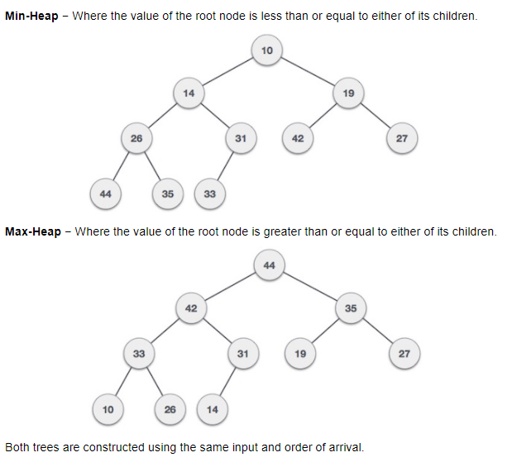

Slide 28
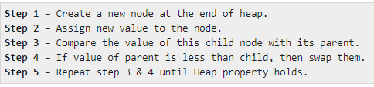
Max Heap Construction Algorithm

Slide 29
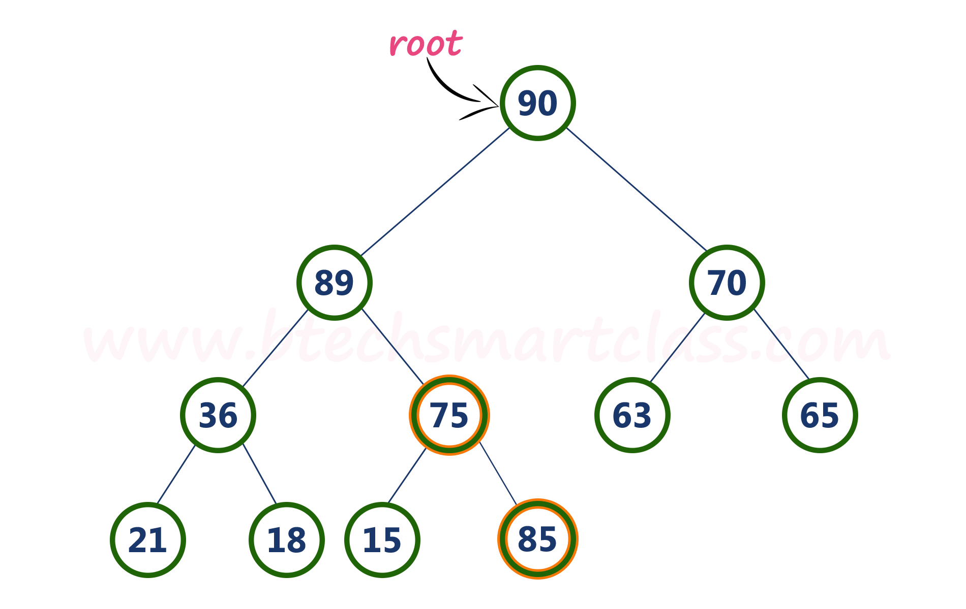
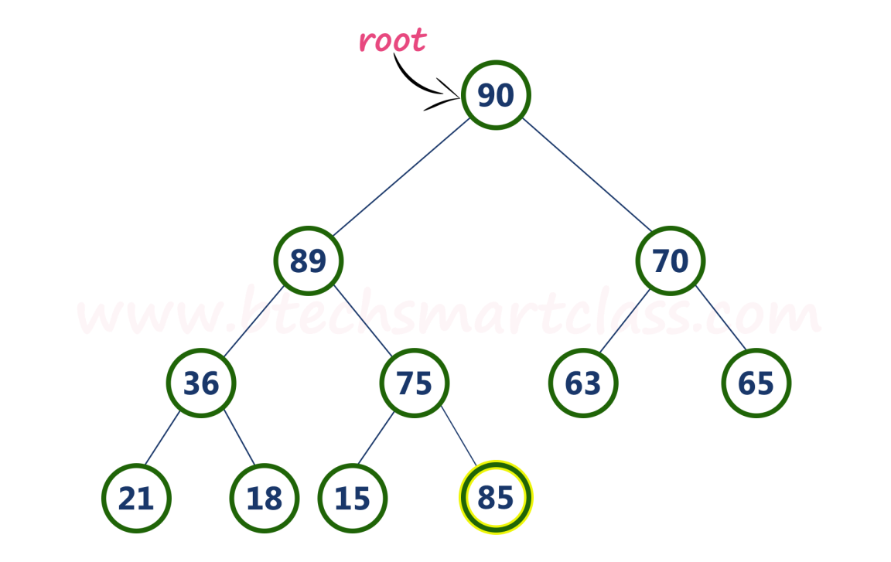
Example :max heap. Insert a new node with value 85.
Step 1 - Insert the newNode with value 85 as last leaf from left to right. That means newNode is added as a right child of node with value 75. After adding max heap is as follows...
Step 2 - Compare newNode value (85) with its Parent node value (75). That means 85 > 75

Slide 30
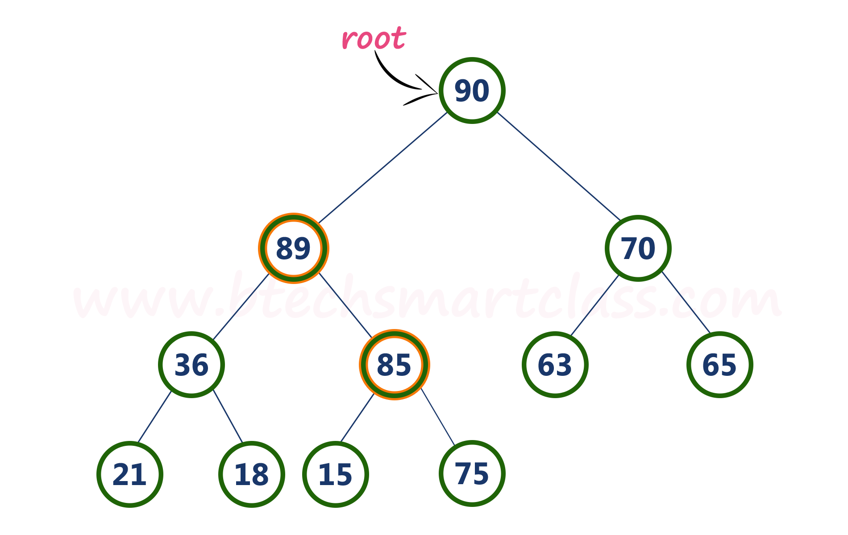
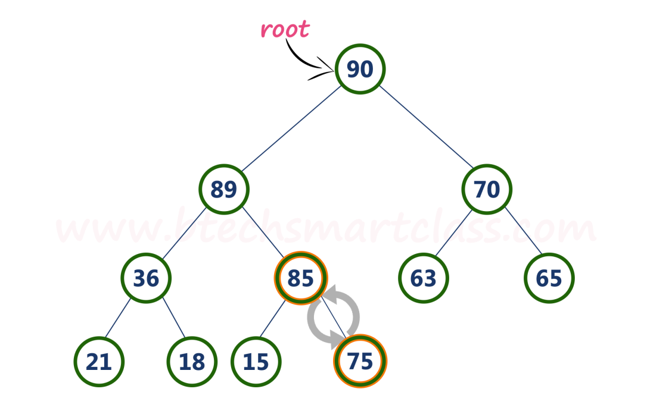
Step 3 - Here newNode value (85) is greater than its parent value (75), then swap both of them. After swapping, max heap is as follows...
Step 4 - Now, again compare new Node value (85) with its parent node value (89).

Slide 31
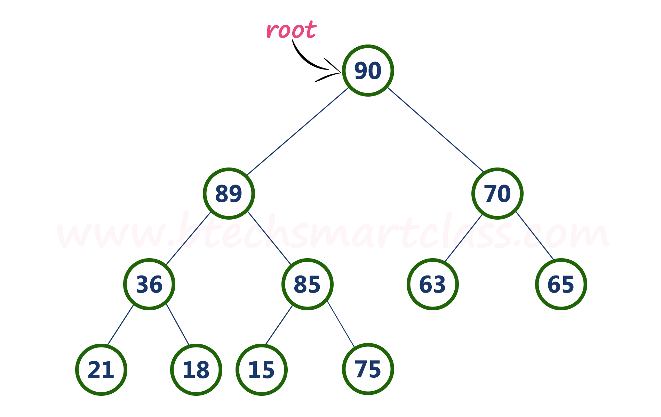
Here, newNode value (85) is smaller than its parent node value (89). So, we stop insertion process. Finally, max heap after insertion of a new node with value 85 is as follows...

Slide 32
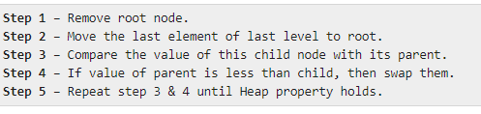
Max Heap Deletion Algorithm

Slide 33
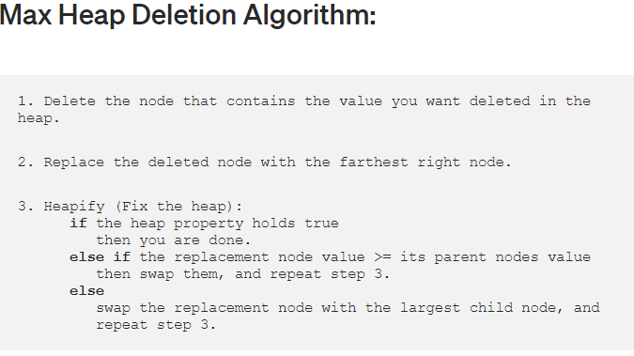

Slide 34
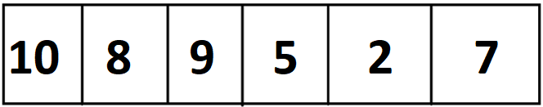
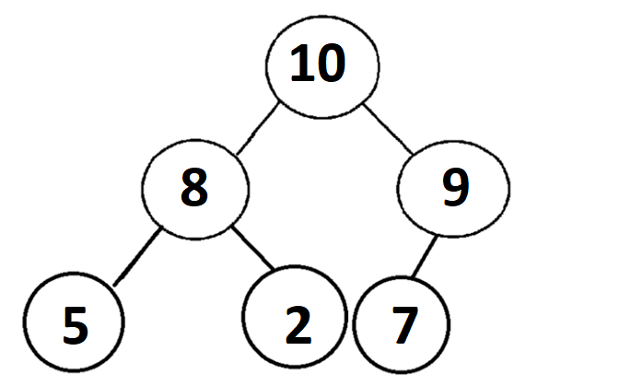
Problem Example:
Step 0: Change the Array Data Structure into a Tree
In order to change an array structure into the tree version of the binary heap, we start from the left to the right of the array, and then insert values into the binary heap from top to bottom and left to right.

Slide 35
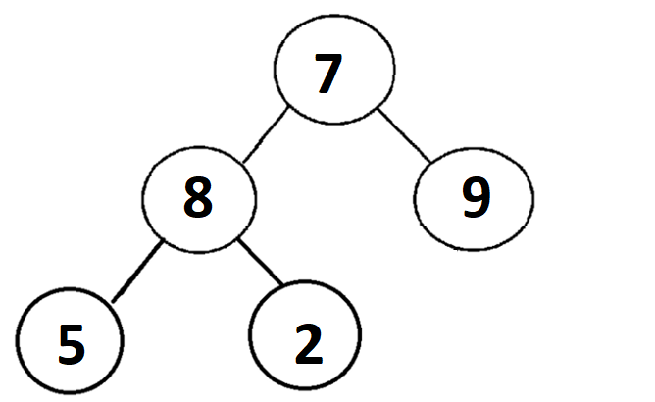
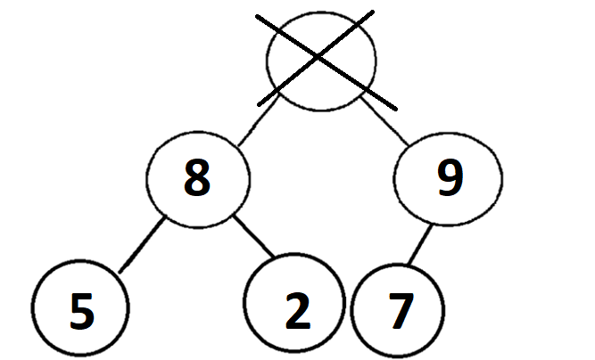
Step 1: Delete the node that contains the value you want deleted in the heap. The value that we want to delete is the maximum value or element in the array which is at the root of the tree. This is the node that contains the value “10”.
Step 2: Replace the deleted node with the
farthest right node.

Slide 36
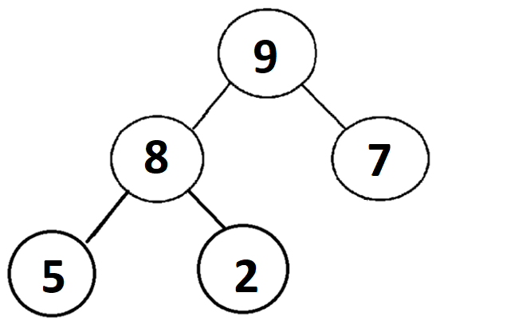
Step 3: Heapify (Fix the heap):
The value “7” at the root of the tree is less than both of its children, the nodes containing the value “8” and “9”. We need to swap the “7” with the largest child, the node containing the value “9”.

Slide 37
Heap sort
Heaps can be used in sorting an array.
In max-heaps, maximum element will always be at the root. Heap Sort uses this property of heap to sort the array.
Consider an array Arr which is to be sorted using Heap Sort.
1. Initially build a max heap of elements in Arr.
2. The root element, that is Arr[1], will contain maximum element of Arr. After that, swap this element with the last element of Arr and heapify the max heap excluding the last element which is already in its correct position and then decrease the length of heap by one.
3. Repeat the step 2, until all the elements are in their correct position.

Slide 38
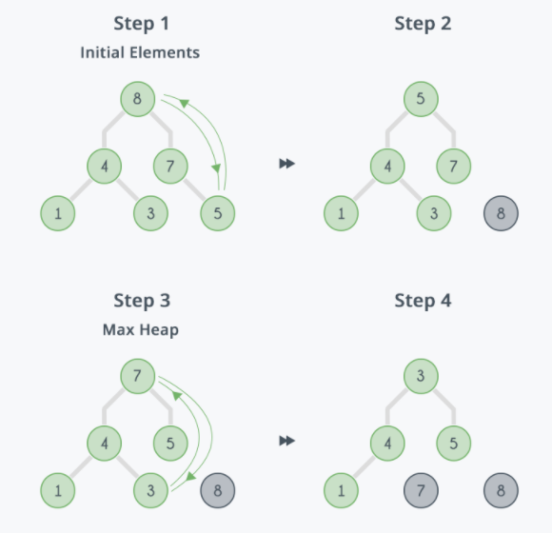
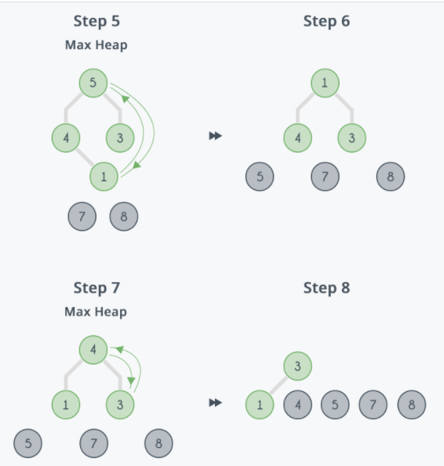

Slide 39
Heap sort-complexity
max_heapify has complexity O(logN),
build_maxheap has complexity O(N) and we run max_heapify N−1 times in heap_sort function, therefore complexity of heap_sort function is O(NlogN).

Slide 40
Heap Applications

Slide 41
Three common applications of heaps
Three common applications of heaps are
selection algorithms,
Priority queues, and
sorting.

Slide 42
Selection Algorithms
There are two solutions to the problem of determining the kth element in an unsorted list.
We could first sort the list and select the element at location k, or we could create a heap and delete k – 1 elements from it, leaving the desired element at the root.
Rather than simply discard the elements at the top of the heap, a better solution is to place the deleted element at the end of the heap and reduce the heap size by 1.
After the kth element has been processed, the temporarily removed elements can then be reinserted into the heap.

Slide 43
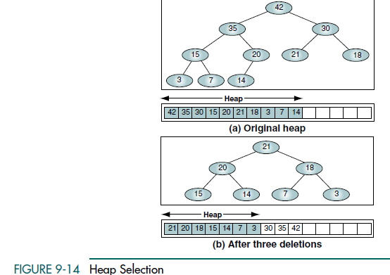
For example, if we want to know the fourth-largest element in a list, we can create the heap shown in Figure 9-14. After deleting three times, we have the fourth-largest element, 21, at the top of the heap.
After selecting 21 we re-heap to restore the heap so that it is complete and we are ready for another selection.

Slide 44
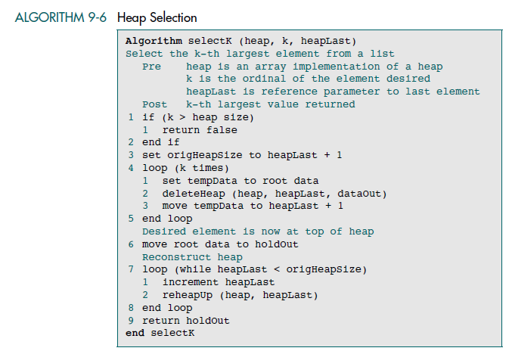

Slide 45
Priority Queues
The heap is an excellent structure to use for a priority queue.
As an event enters the queue, it is assigned a priority number that determines its position relative to the other events already in the queue.
It is assigned a priority number even though the new event can enter the heap in only one place at any given time, the first empty leaf.

Slide 46
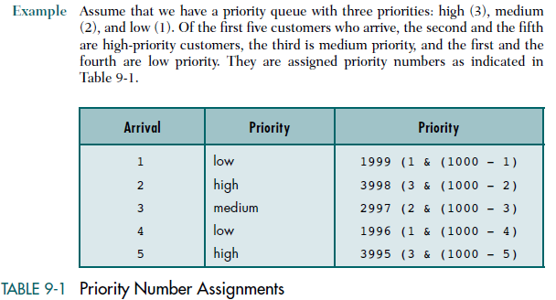

Slide 47
